Slide 1
THE DIFFRENCE BETWEEN HARDWARE AND SOFTWARE

Slide 2
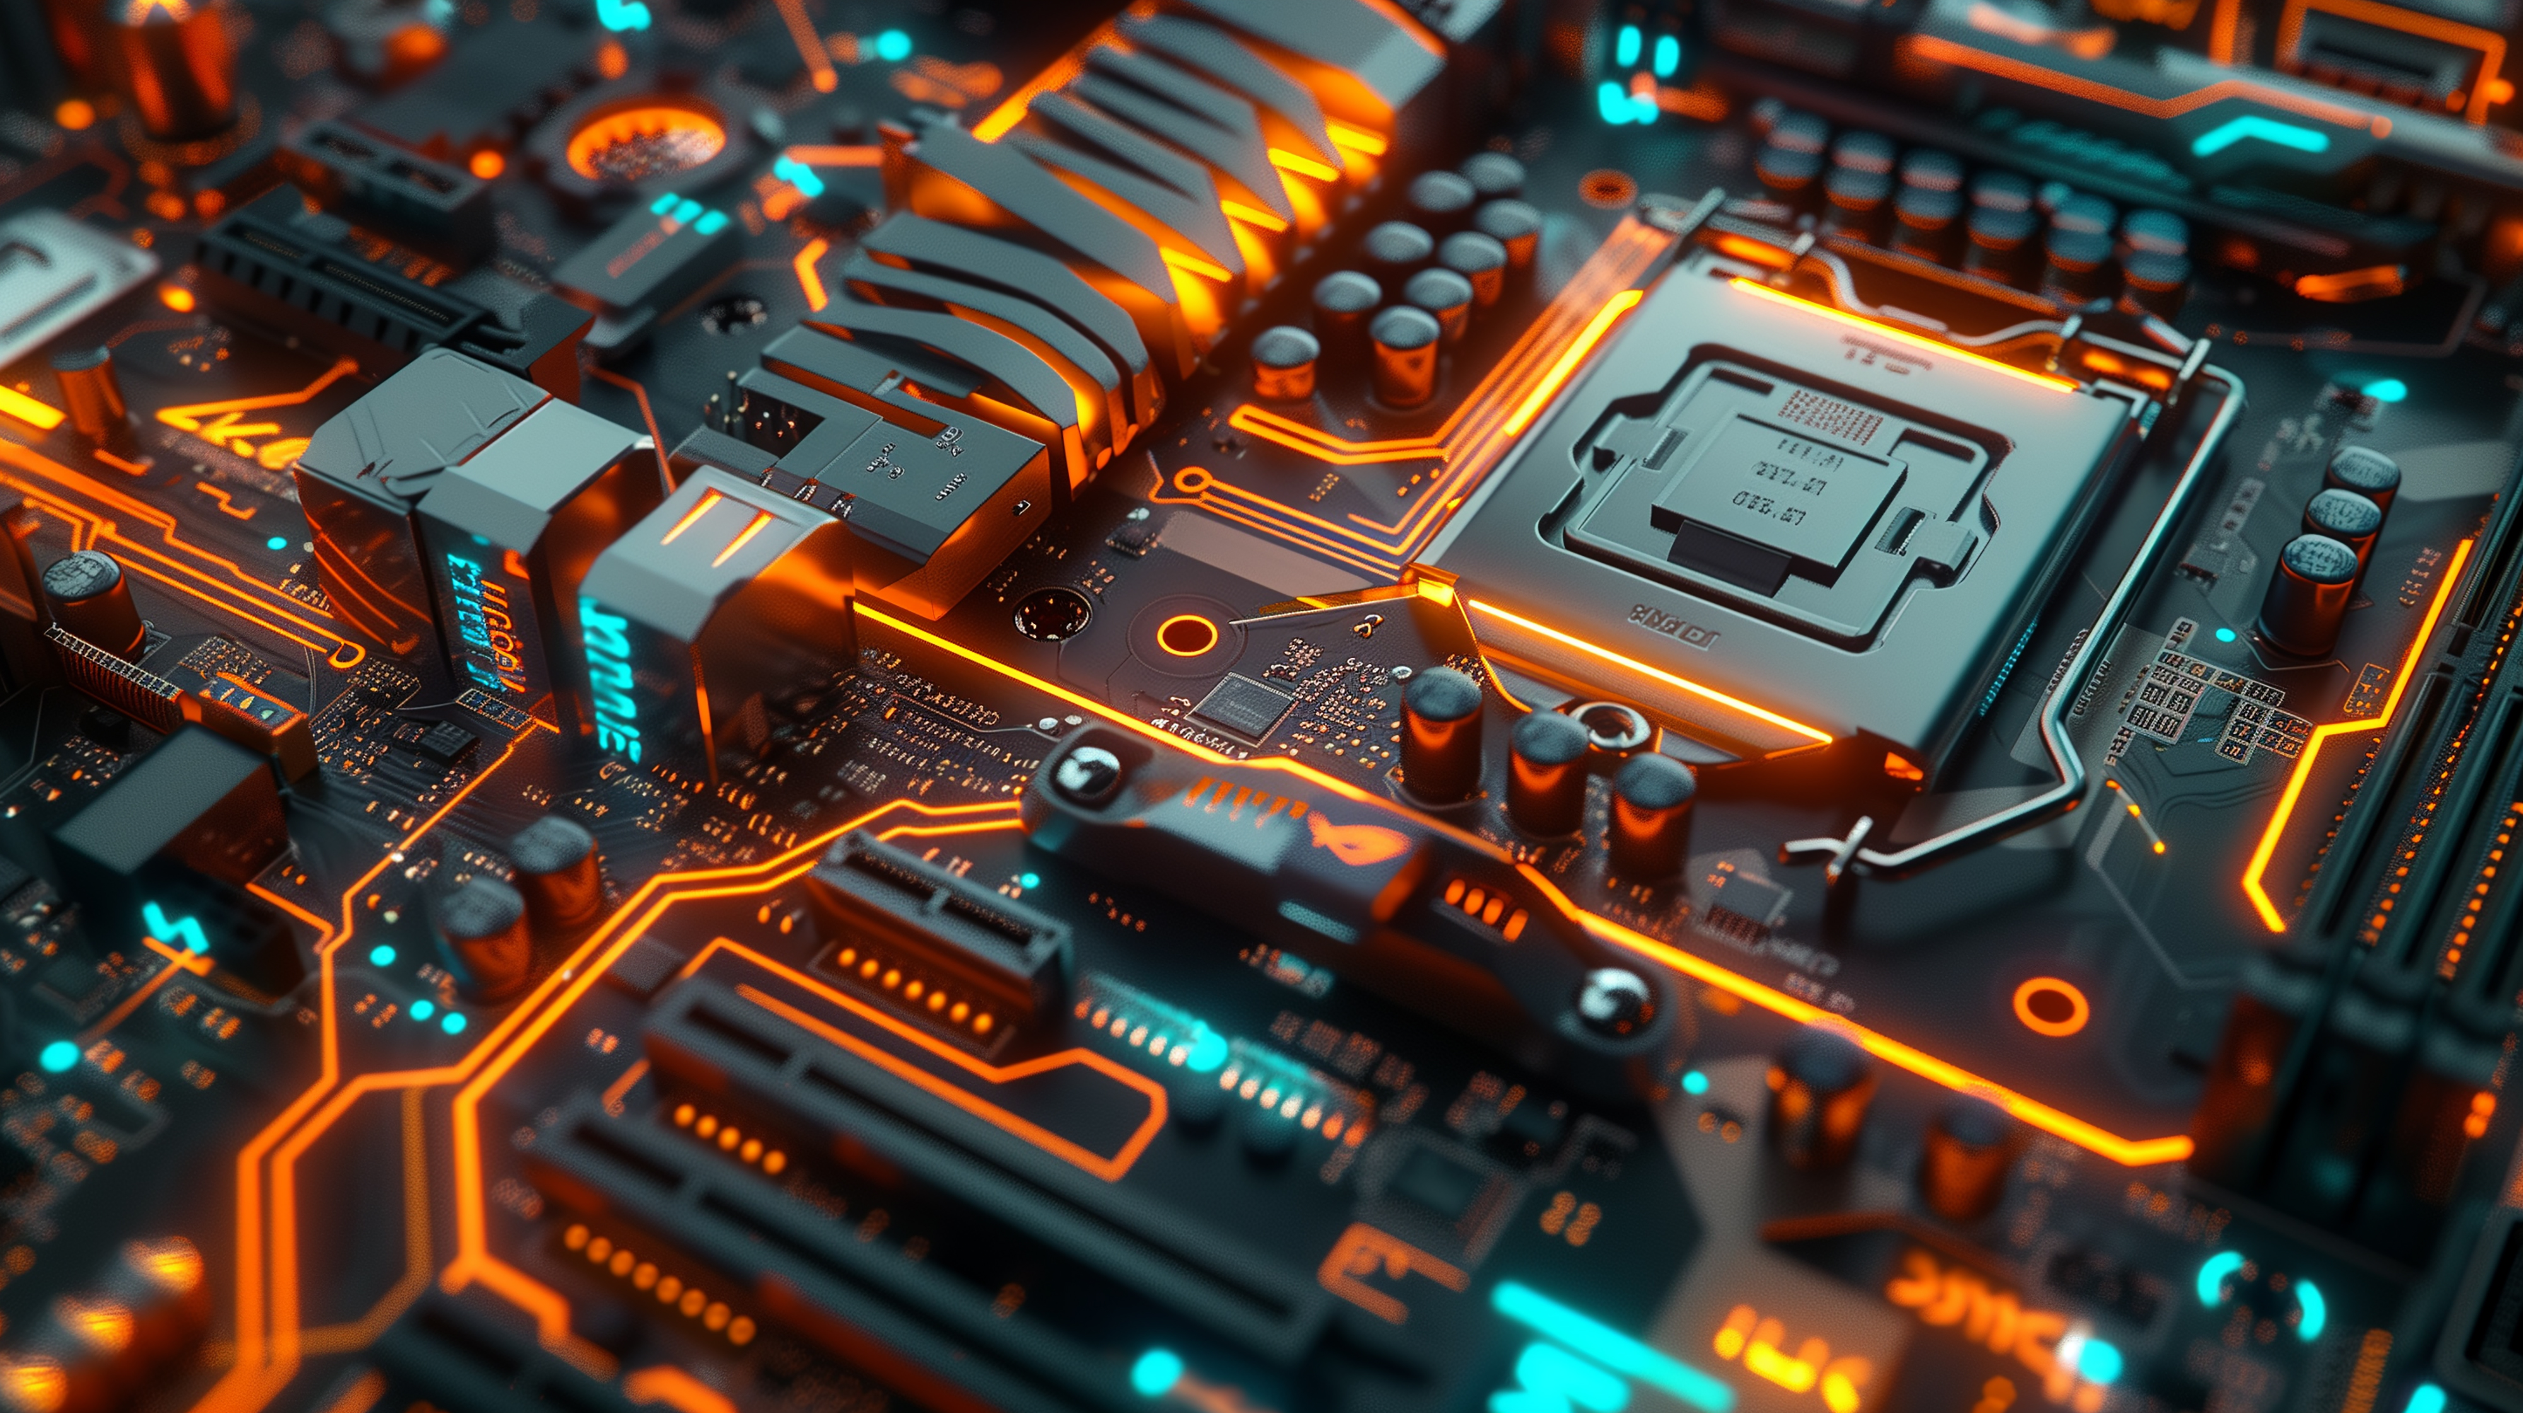
WHAT IS HARDWARE ?
Hardware Is The Stuff You Can Touch In A Computer. It's Like The Body Parts Of A Computer.

Slide 3
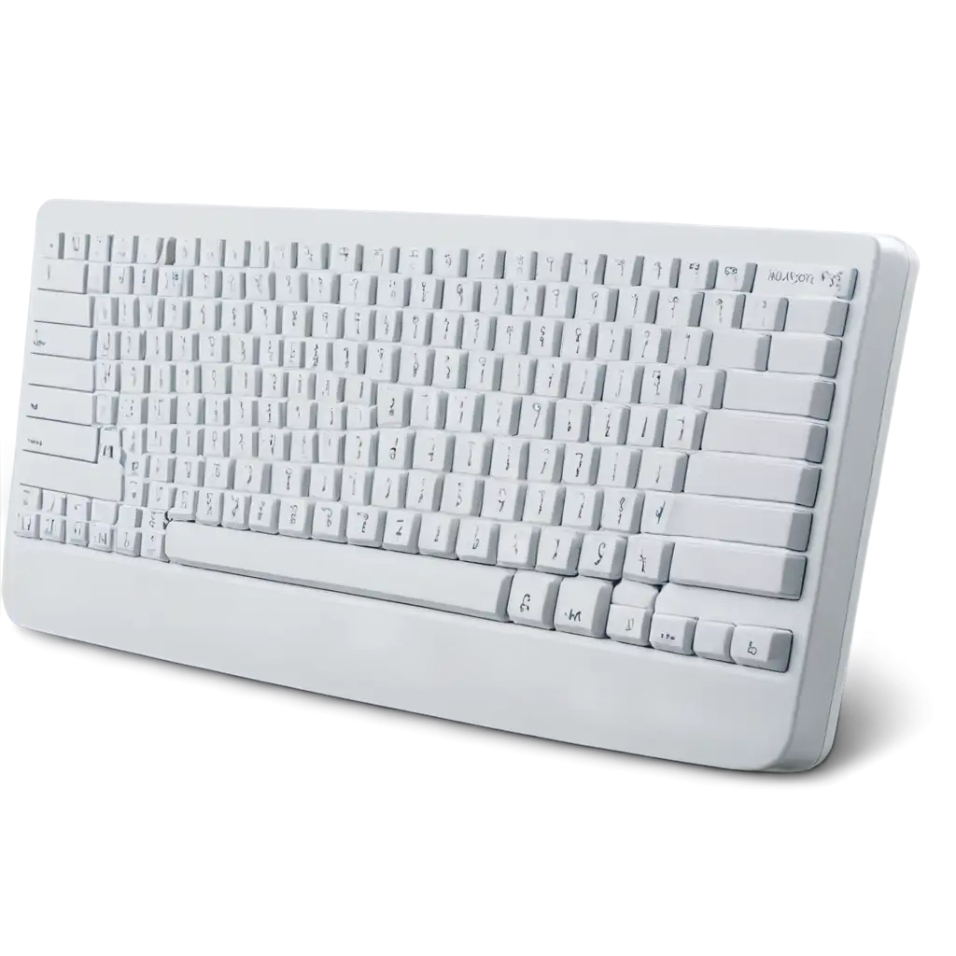
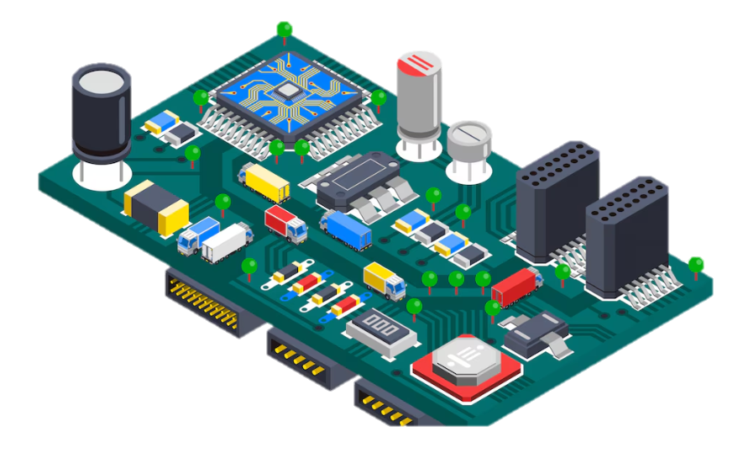
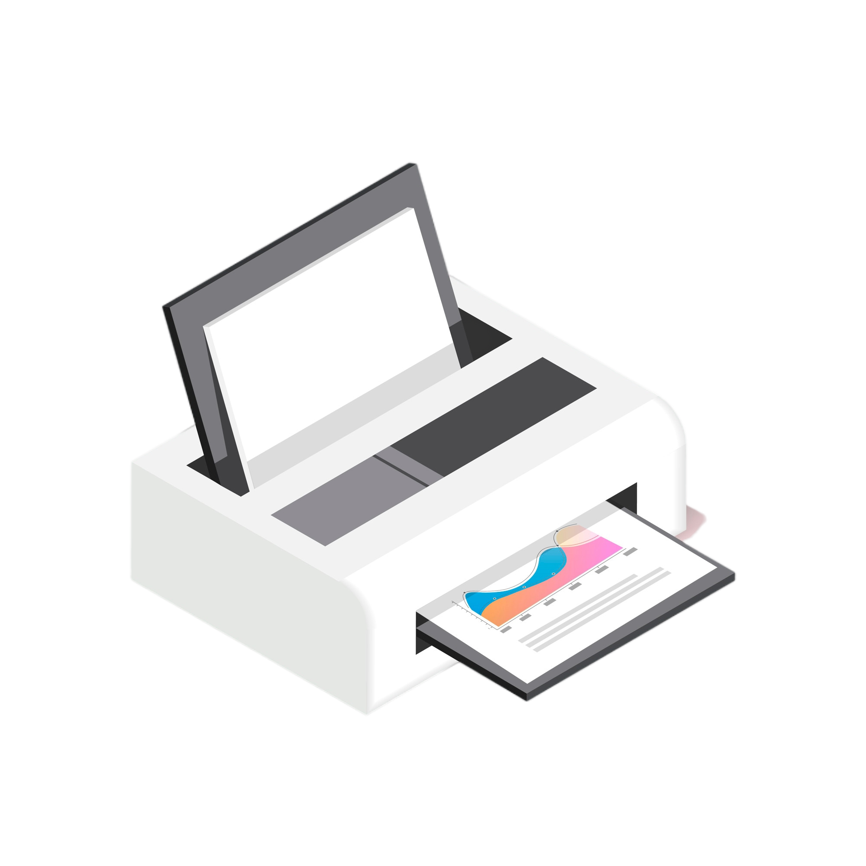
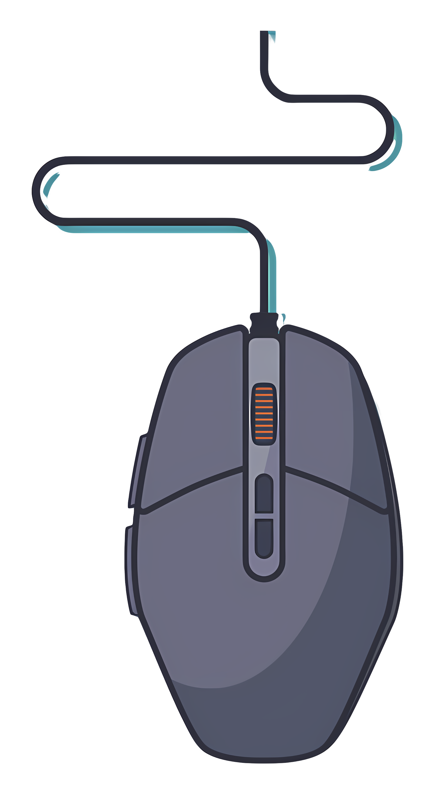
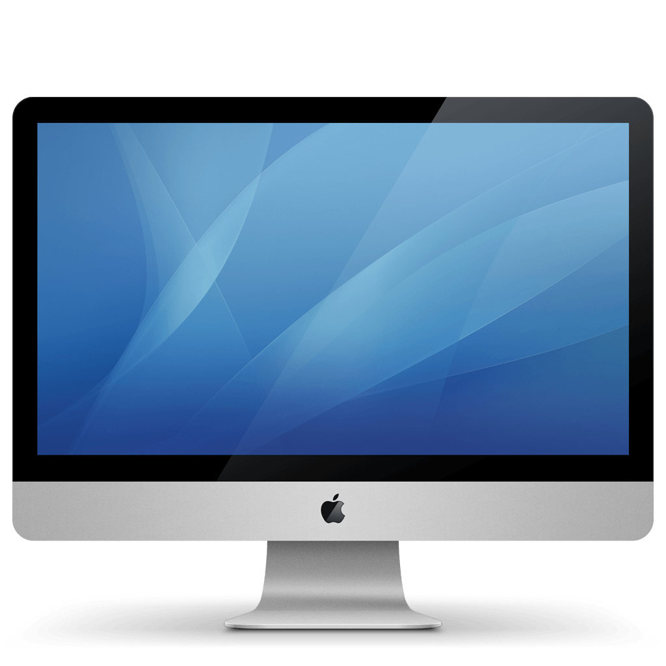
HARDWARE EXAMPLE →
01
02
03
04
Motherboard
keyboard
05
printer
monitor
mouse

Slide 4


THERE ARE TWO TYPES OF DEVICE IN HARDWARE.
INPUT DEVICE
OUTPUT DEVICE

Slide 5
INPUT DEVICE
OUTPUT DEVICE
. KEYBOARD
. MOUSE
. JOY STICK
. LIGHT PEN
. BARCODE READER
. MONITOR
. PRINTER
. SPEAKERS
. HEADPHONES
. PROJECTORS

Slide 6
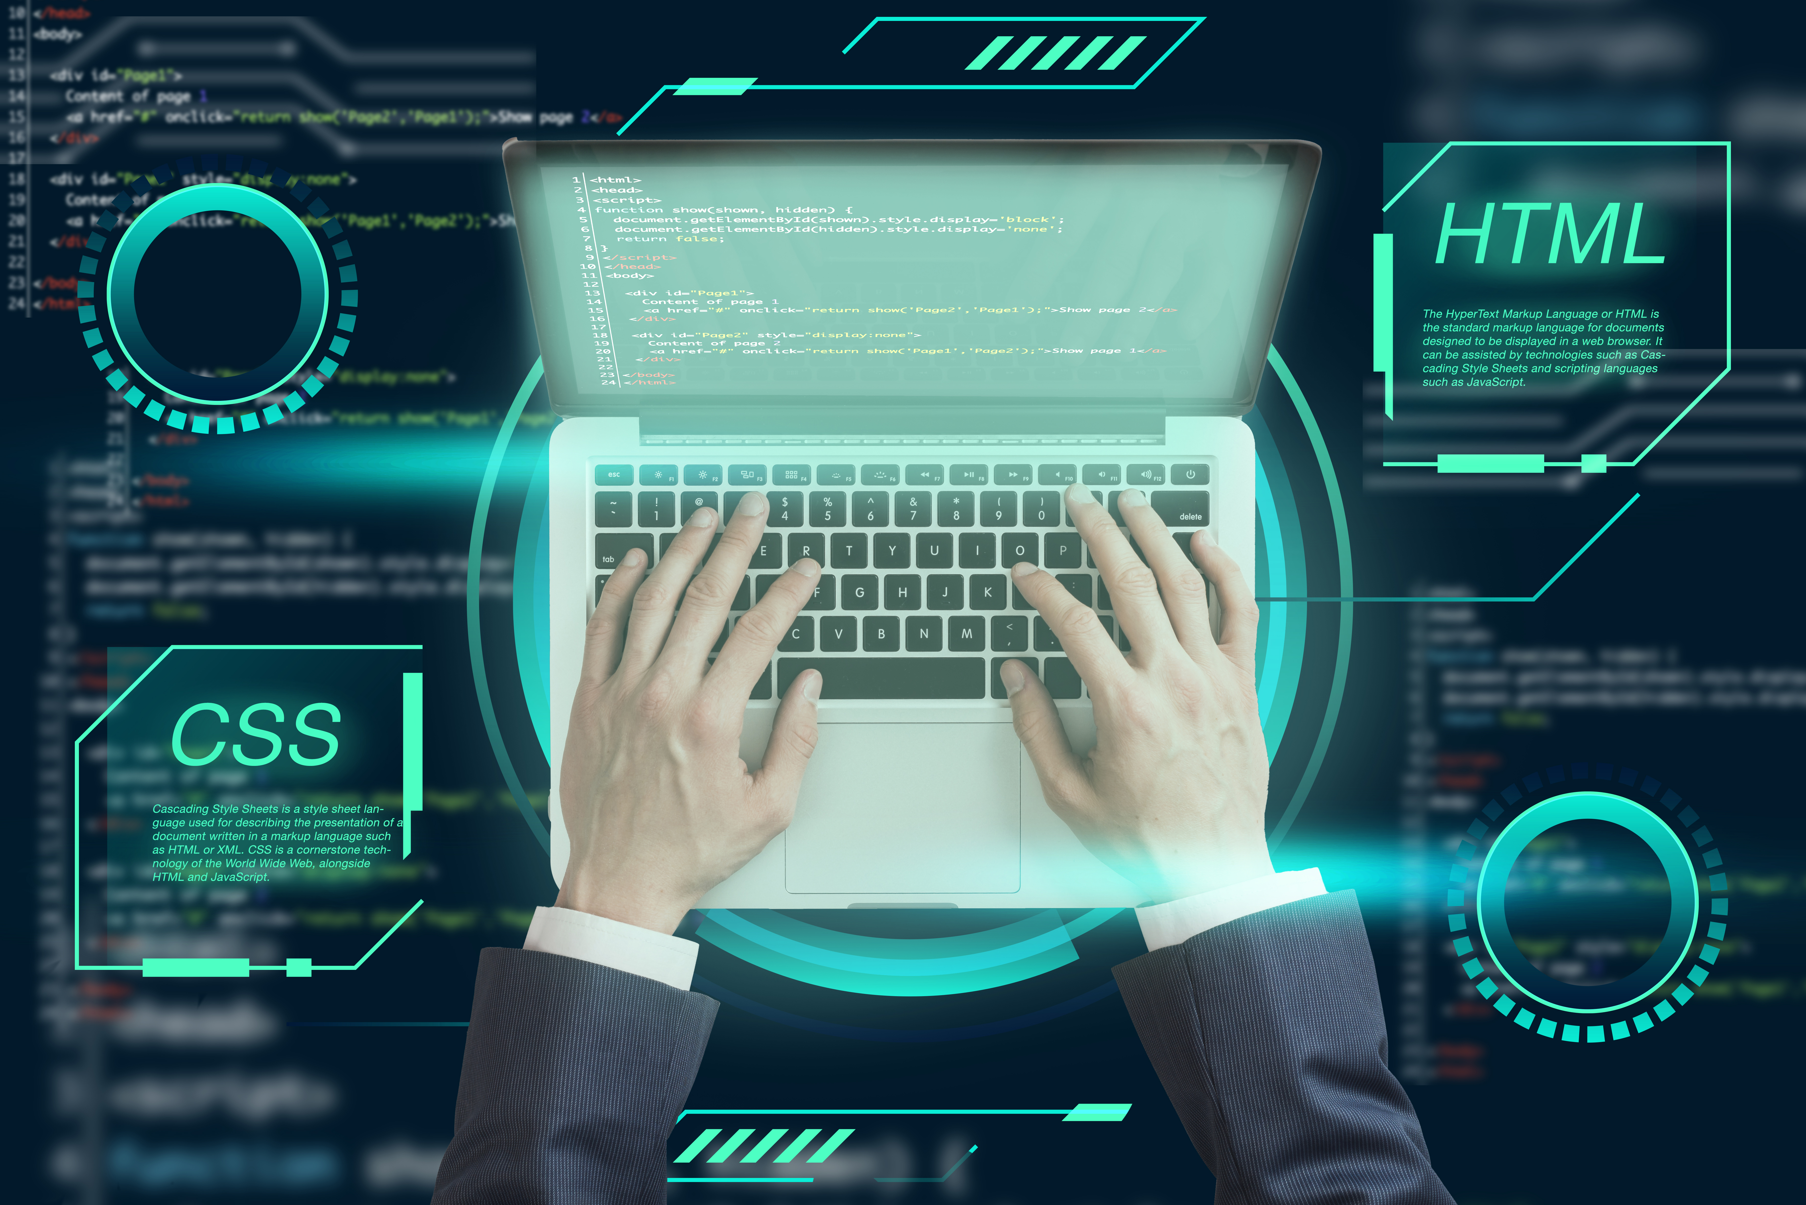
WHAT IS SOFTWARE ?
Software is like the brain of a computer. It's the set of instructions that tells the hardware what to do.

Slide 7

TYPES OF SOFTWARE
system software
application software.
utility software

Slide 8
01
SYSTEM SOFTWARE
The most important system software is called an operating system (OS). This is like the mayor of the city! It tells all the other software what to do.
EXAPMLE = MACOS, LINUX, ANDROID, AND MICROSOFT WINDOWS

Slide 9
02
APPLICATION SOFTWARE
Application software (App) is a kind of software that performs specific functions for the end user by interacting directly with it.
EXAPMLE = YOUTUBE , GMAIL , PLAYSTORE , CHROME

Slide 10
03
UTILITY SOFTWARE
Utility Software refers to a type of system software that is designed to help Analyse , configure, Optimise and maintain a computer
EXAPMLE = ANTIVIRUS SOFTWARE, DISK CLEANERS, BACKUP SOFTWARE, FILE COMPRESSION SOFTWARE

